Slide 1



Admission Prediction using ML
Made By PARIK SHARMA
Group 16

Slide 2
Content
A. Exploratory Data Analysis
1. Import the data to a Dataframe using Pandas
2. Visualizing the relationship b/w feature and target variables
B. Data Preprocessing
3. Splitting Dataframe into Feature variable (x) and Dependent variable (y)
4. Split x and into training and testing sets
C. Multiple Linear Regression
5. Instanting the Linear Regression model and fitting the model
6. Calculating the intercept (c) and the coefficient (coef)
7. Printing the equation (y = m ₁ x ₁ + m ₂ x ₂ + m ₃ x ₃ + _ _ _ _ + m _{n} x _{n} + c)
8. Implementing the above equation and predicting the admit score
9. Plotting the Predicted vs Actual values using scatterplot w.r.t Muliple Linear Regression
10. Computing the metrics for mean absoute error, mean squared error, root mean squared error, and R-squared to determined the model performance

Slide 3
Content
D. Random Forest Regressor
11. Instanting the Random Forest Regressor model and fitting the model
12. Predicting the admit score
13. Computing the metrics for mean squared error and R-squared to determined the model performance
14. Plotting the Predicted vs Actual values using scatterplot w.r.t Random Forest Regressor.
C. MLR with PCA
15. Standardizing the data
16. Principal Component Analysis (PCA)
17. After PCA New dataset with 2 features and 1 target variable.
18. Visualizing new dataset
19. Splitting new dataset into independent (x_pca) and dependent (y_pca) variable
20. Split x_pca and y_pca into training and testing sets
21. Creating Linear Regression object and fitting the model
22. Plotting the Predicted vs Actual values using scatterplot w.r.t Muliple Linear Regression

Slide 4
Content
23. Computing the metrics for mean squared error and R-squared to determined the model performance
24. Visualizing using 3D graph
25. Multiple Linear Regression on first component
26. Splitting into traning and testing sets
27. Fittting the model and predicting the result.
28. Visualizing the Acutal vs Predicted values
29. Computing the metrics for mean squared error and R-squared to determined the model performance
30. Plotting the graph for chance of getting in
31. Multiple Linear Regression on 2nd component
32. Splitting into traning and testing sets
33. Fittting the model and predicting the result.
34. Visualizing the Acutal vs Predicted values
35. Computing the metrics for mean squared error and R-squared to determined the model performance.
36. Plotting the graph for chance of getting in
D. RFR with PCA
37. Creating Random Forest Regression object and fitting the model

Slide 5
Content
38. Computing the metrics for mean squared error and R-squared to determined the model performance.
39. Random Forest Regression on first PCA component
40. Plotting the graph for chance of getting in
41. Computing the metrics for mean squared error and R-squared to determined the model performance
42. Random Forest Regression on 2nd PCA component
43. Plotting the graph for chance of getting in
44. Computing the metrics for mean squared error and R-squared to determined the model performance

Slide 6
Introduction
Admission prediction Using Machine Learning:
Students are often worried about their chances of admission in graduate. The aim of this project is to help students in shortlisting universities with their profiles. The predicted output gives them a fair idea about their admission chances in a particular university.
This analysis should also help students who are currently preparing or will be preparing to get a better idea.
Features of this Admissions dataset:
1. Serial Number.
2. GRE score.
3. TOEFL score.
4. University Rating.
5. SOP.
6. LOR.
7. CGPA.
8. Research.
9. Chance of Admit.

Slide 7
Software used
Jupyter notebook
WPS Office
Algorithm Used
Multiple Linear Regression
Random Forest Regression
Principal Component Analysis

Slide 8
A. Exploratory Data Analysis

Slide 9
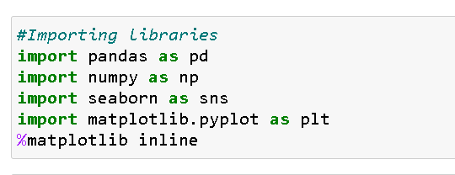
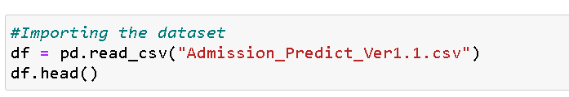
1. Import the data to a Dataframe using Pandas
import function is used to import the libraries
as function is used to import the libraries using an alias name
pd.read_csv() function of pandas library is used to import the data as a dataframe

Slide 10
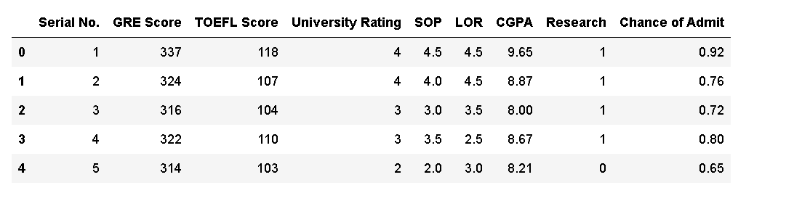
head() function is used to display first five rows of the dataset

Slide 11
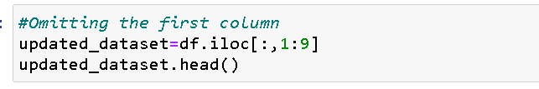
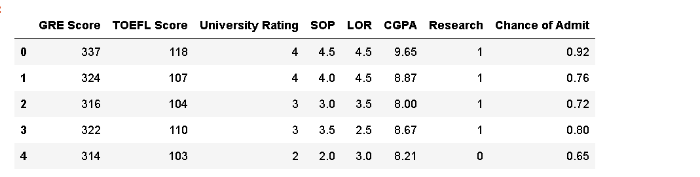
We don’t need first column serial no. so we omit it and copy the new dataset into updated_dataset variable.

Slide 12
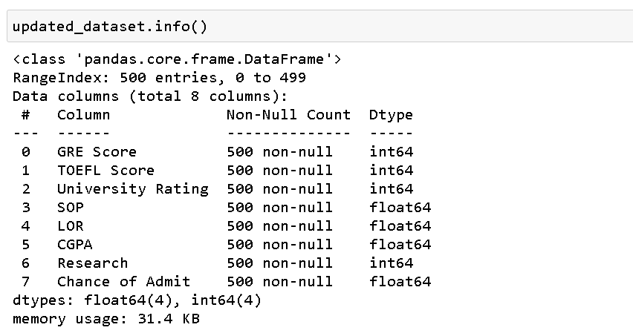

Slide 13
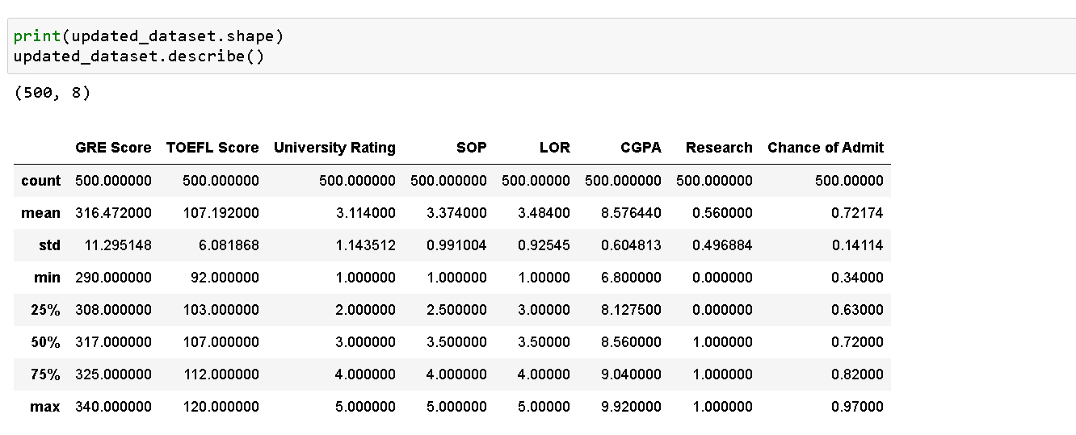
Key Highlights from dataset:
Average GRE Score: 316.47
Average TOEFL Score: 107.19
Average CGPA: 8.58

Slide 14
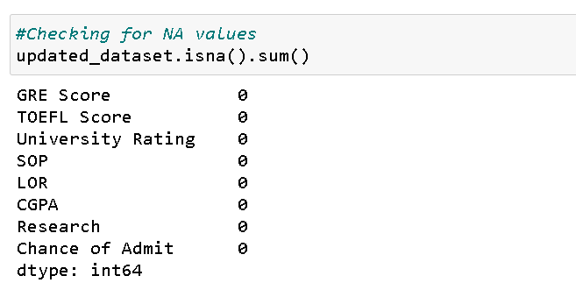
In the dataset there is no null values. isna() function is used to check if there is null values in the data or not.

Slide 15
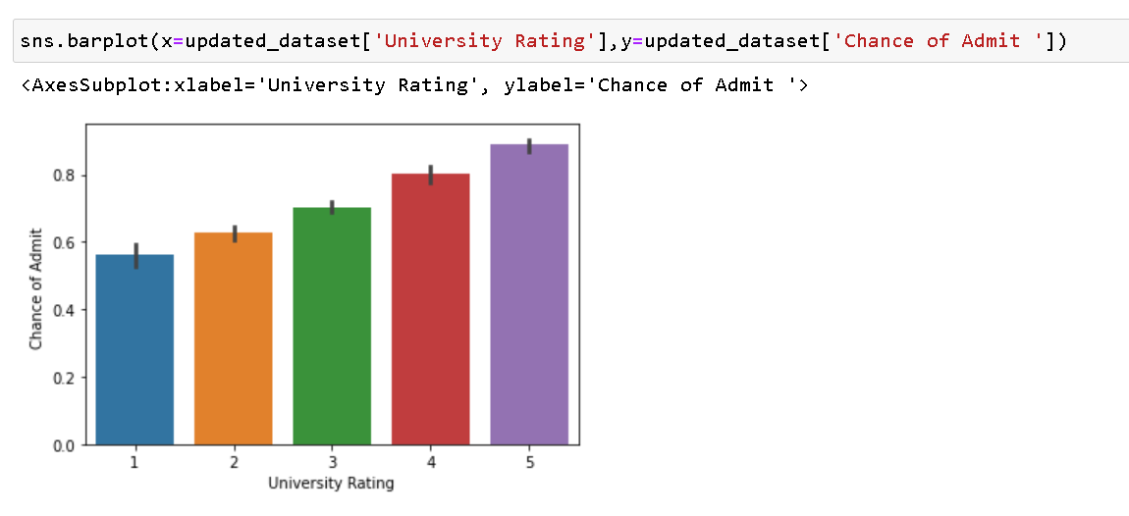
2. Visualizing the relationship b/w feature and target variables
University Rating Vs Chance of Admit
This bargraph shows that there are high chances of getting admission in tier 5 college, then 4 and so on

Slide 16
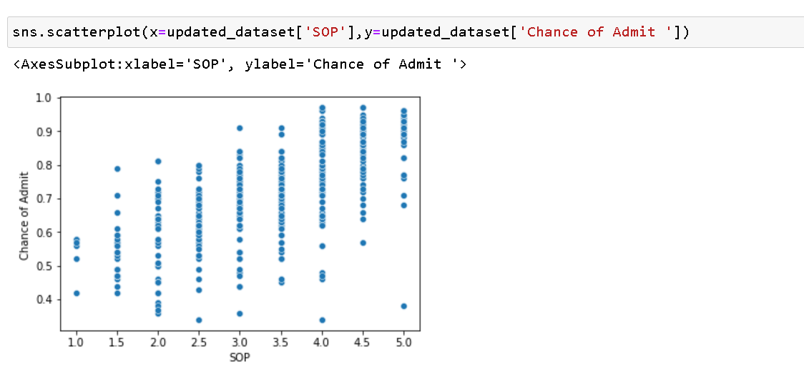
SOP Vs Chance of Admit

Slide 17
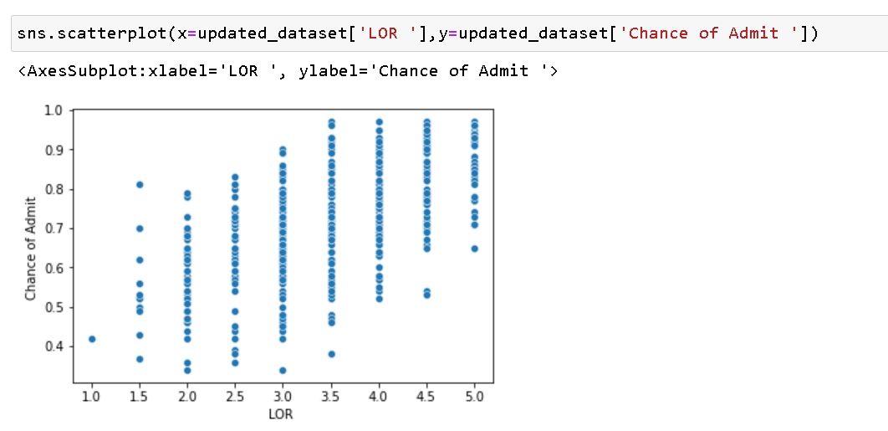
LOR Vs Chance of Admit

Slide 18
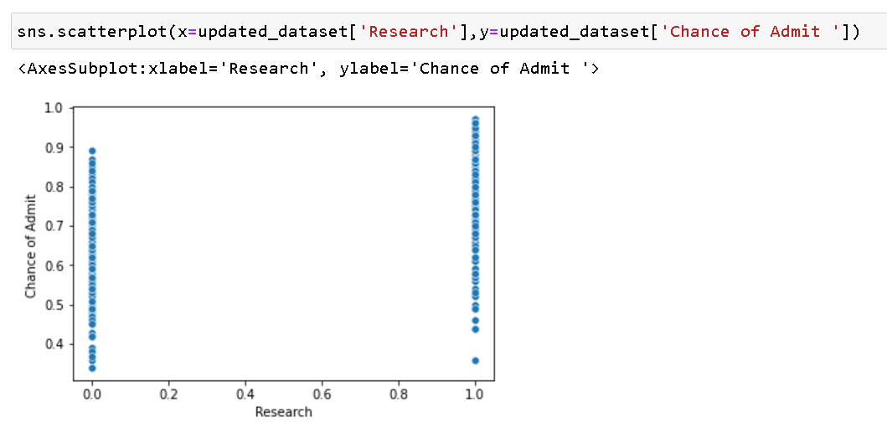
Research Vs Chance of Admit

Slide 19
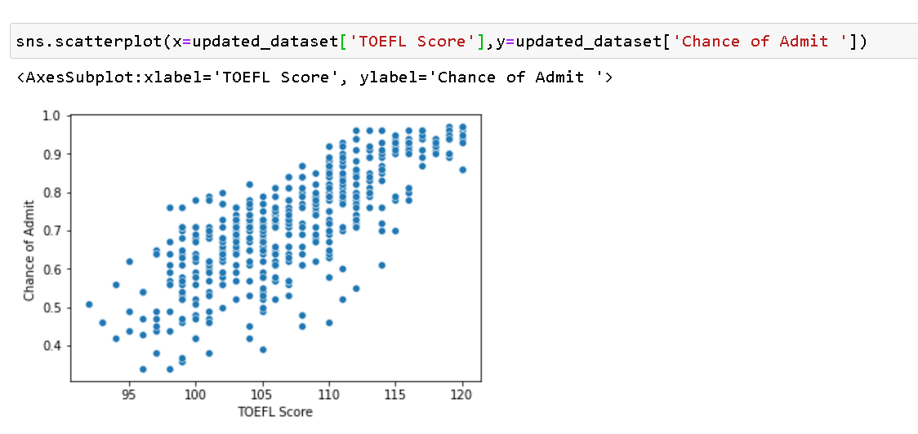
TOEFL Score Vs Chance of Admit

Slide 20
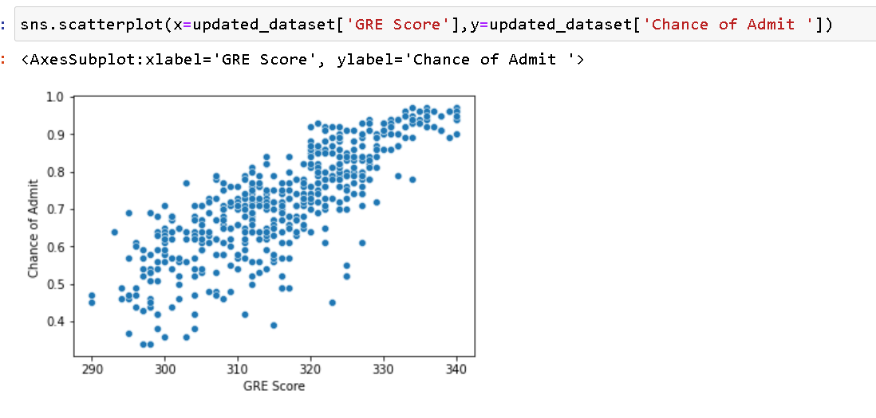
GRE Score Vs Chance of Admit

Slide 21
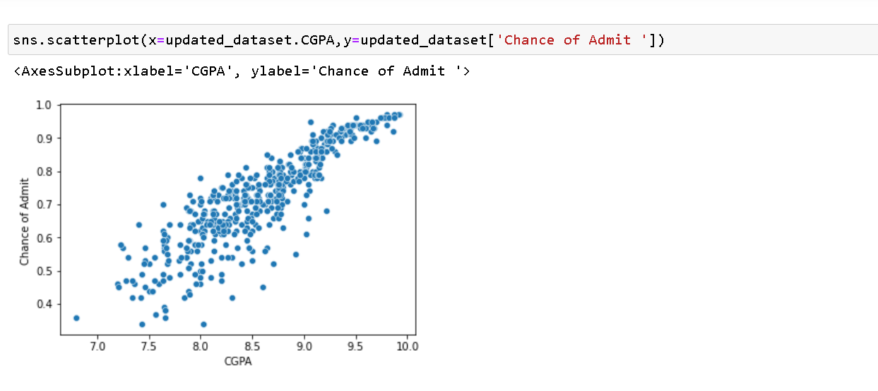
CGPA Vs Chance of Admit
From the above scatter plots, we notice that as the GRE,CGPA and TOEFL increase the change of getting the admission increase too, there is a linear relationship between them.

Slide 22
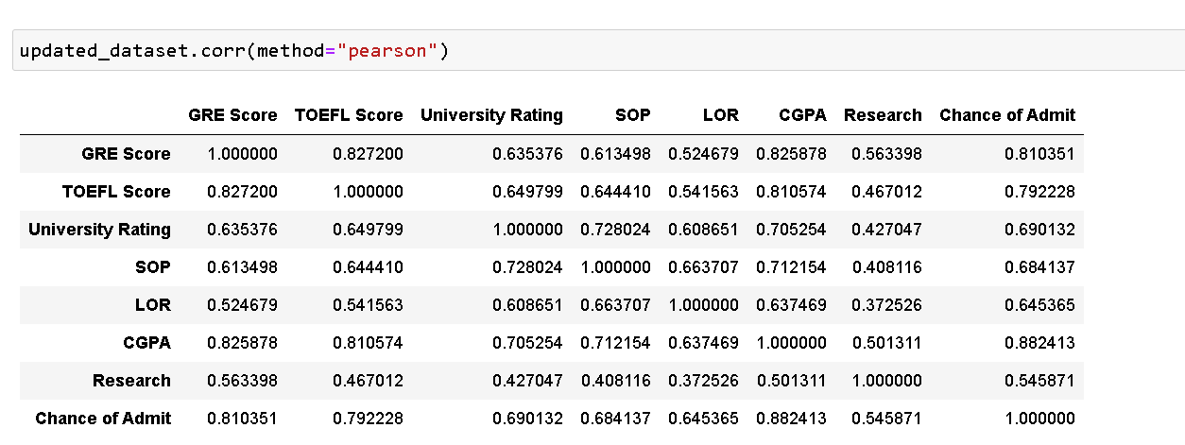
Pandas dataframe.corr() is used to find the pairwise correlation of all columns in the dataframe. Any na values are automatically excluded. For any non-numeric data type columns in the dataframe it is ignored.

Slide 23
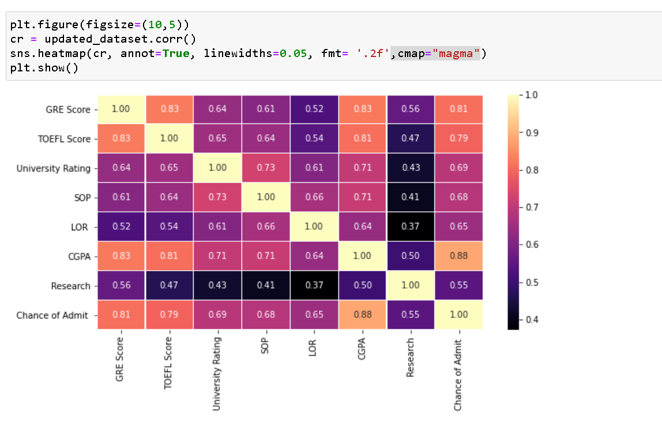
Following are highest correlated items with Chance of admit:
CGPA
GRE Score
TOEFL Score

Slide 24
From EDA we get following information: -
CPGA plays the most important role in admissions followed by GRE score and TOEFL.
Good SOPs and LORs are essential to get into the best universities
Studious students generally tend to do good at GRE and TOEFL.

Slide 25
B. Data Preprocessing

Slide 26
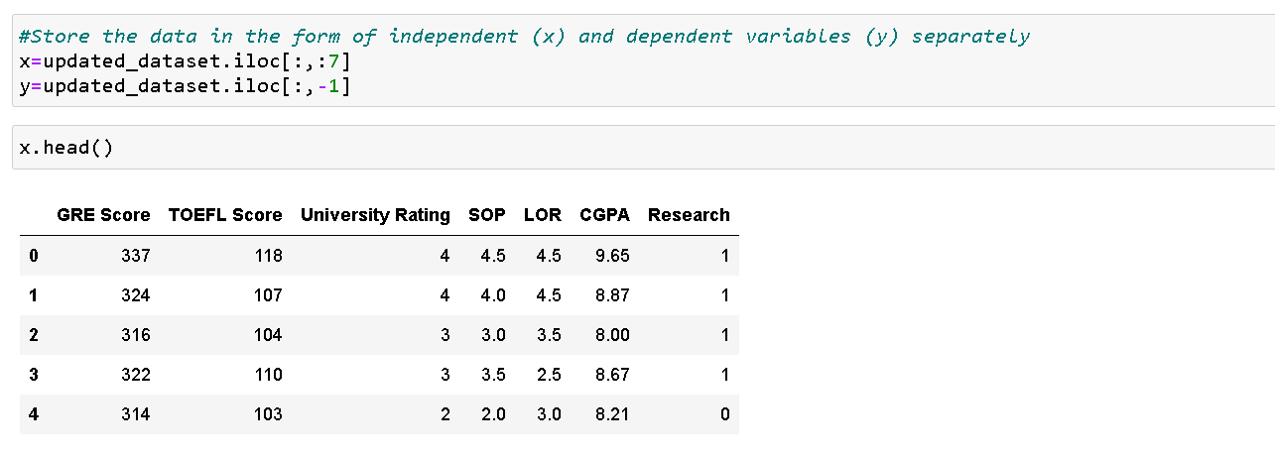
3. Splitting Dataframe into Feature variable (x) and Dependent variable (y)
x is independent variable.

Slide 27
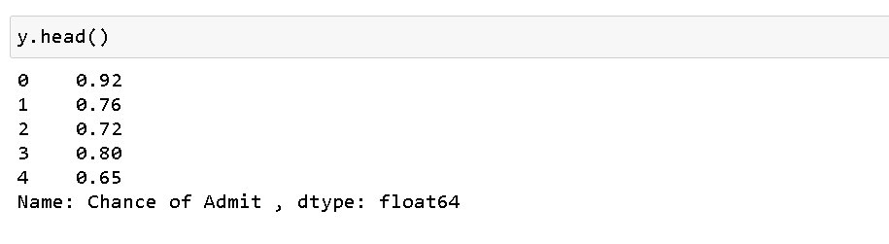
y is dependent variable.

Slide 28
4. Split x and y into training and testing sets
train_test_split function of sklearn.model_selection is used to split the data into training and testing sets.

Slide 29
C. Multiple Linear Regression

Slide 30
Multiple Linear Regression:
Multiple Linear Regression is one of the important regression algorithms which models the linear relationship between a single dependent continuous variable and more than one independent variable.
Assumptions for Multiple Linear Regression:
A linear relationship should exist between the Target and predictor variables.
The regression residuals must be normally distributed.
MLR assumes little or no multicollinearity (correlation between the independent variable) in data.
MLR equation:
In Multiple Linear Regression, the target variable(Y) is a linear combination of multiple predictor variables x1, x2, x3, ...,xn. Since it is an enhancement of Simple Linear Regression, so the same is applied for the multiple linear regression equation, the equation becomes:
y = m ₁ x ₁ + m ₂ x ₂ + m ₃ x ₃ + _ _ _ _ + m _{n} x _{n} + c
Where,
y = Output/Response variable
m 1, m 2, m 3 , m n....= Coefficients of the model.
x 1, x 2, x 3, x 4,...= Various Independent/feature variable

Slide 31
Multiple Linear Regression Steps: -
Data Pre-processing Steps
Fitting the MLR model to the training set
Predicting the result of the test set

Slide 32
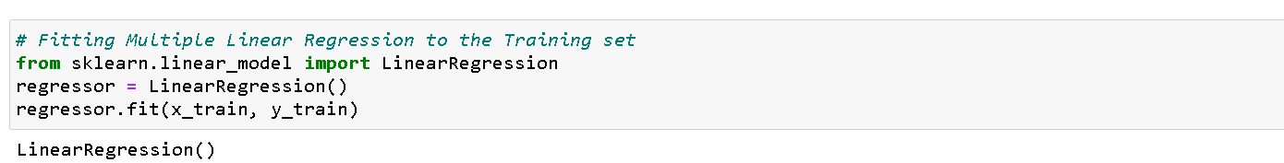
5. Instanting the Linear Regression model and fitting the model

Slide 33
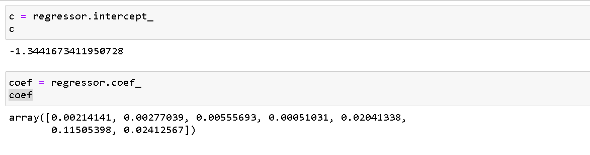
6. Calculating the intercept (c) and the coefficient (coef)

Slide 34
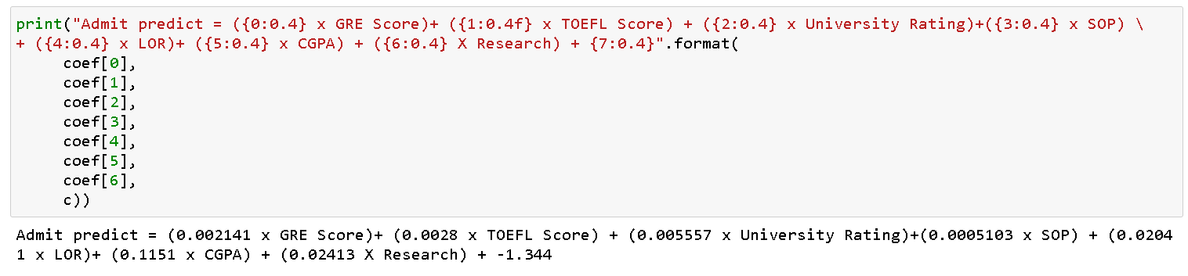
7. Printing the equation (y = m ₁ x ₁ + m ₂ x ₂ + m ₃ x ₃ + _ _ _ _ + m _{n} x _{n} + c)

Slide 35
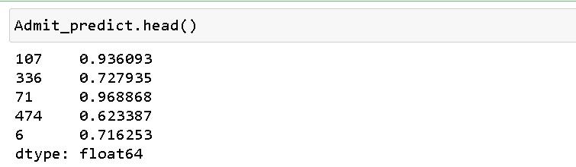
8. Implementing the above equation and predicting the admit score

Slide 36
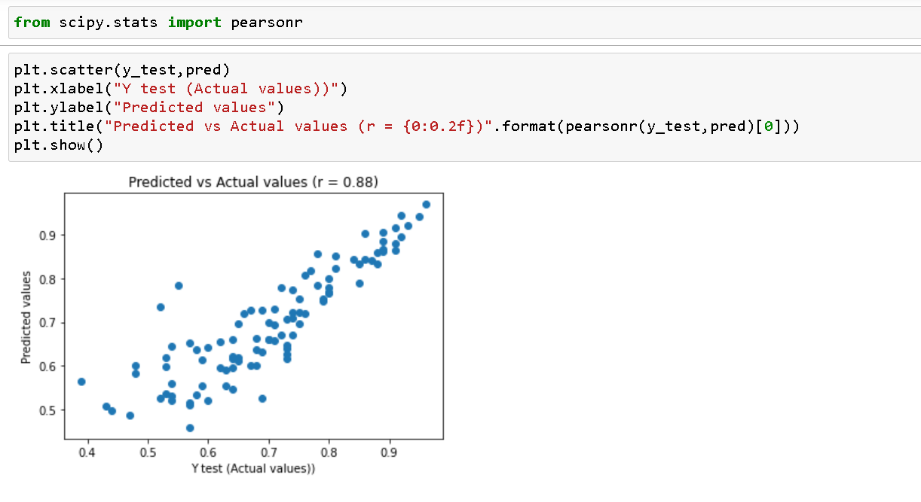
9. Plotting the Predicted vs Actual values using scatterplot w.r.t Muliple Linear Regression

Slide 37
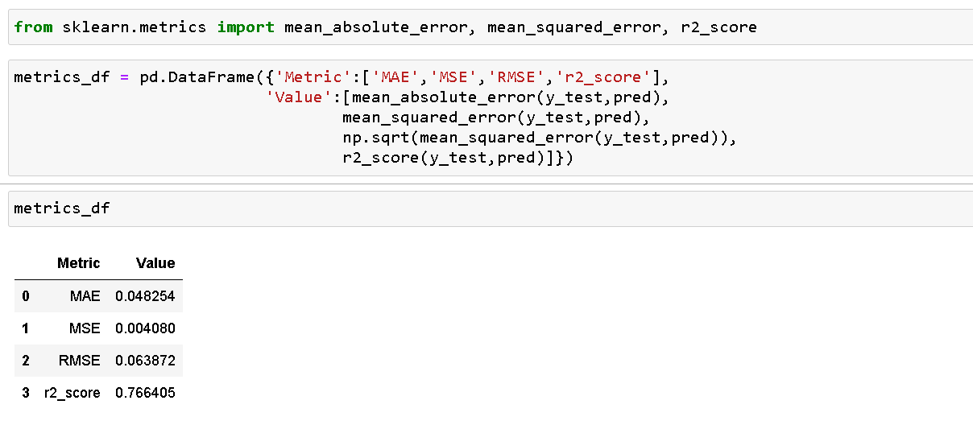
10. Computing the metrics for mean absoute error, mean squared error, root mean squared error, and R-squared to determined the model performance

Slide 38
D. Random Forest Regressor

Slide 39
RANDOM FOREST:
1. Random forest is a type of supervised machine learning algorithm based on ensemble learning.
2. Ensemble learning is a type of learning where we join different types of algorithms or same algorithm multiple times to form a more powerful prediction model.
4. The random forest algorithm can be used for both regression and classification tasks.
3. The random forest algorithm combines multiple algorithm of the same type i.e. multiple decision trees, resulting in a “Forest".

Slide 40
RANDOM FOREST ALGORITHM STEPS:
1. Pick N random records from the dataset.
2. Build a decision tree based on these N records.
3. Choose the number of trees we want in our algorithm and repeat step1 And step2
4. In case of a regression problem, for a new record, each tree in the forest predicts a value for Y (output). The final value can be calculated by taking the average of all the values predicted by all the trees in forest.
4. In case of a classification problem, each tree in the forest predicts the category to which the new record belongs. Finally, the new record is assigned to the category that wins the majority vote.

Slide 41
Advantages of using Random Forest
The random forest algorithm is not biased, since, there are multiple trees and each tree is trained on a subset of data. Basically, the random forest algorithm relies(depend) on the power of "the crowd"; therefore the overall biasedness of the algorithm is reduced.
This algorithm is very stable. Even if a new data point is introduced in the dataset the overall algorithm is not affected much since new data may impact one tree but it is very hard for it to impact all the trees.
The random forest algorithm works well when you have both categorical and numerical features.
The random forest algorithm also works well when data has missing values or it has not been scaled well.
Disadvantages of random forest:
A major disadvantage of random forests lies in their complexity. They required much more computational resources, owing to the large number of decision trees joined together.
Due to their complexity, they require much more comparable algorithms

Slide 42
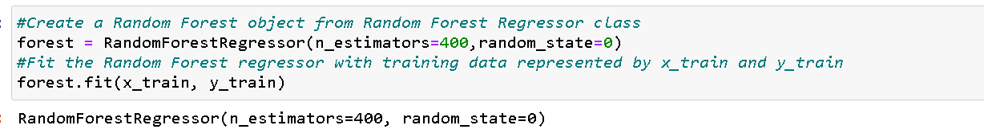
11. Instanting the Random Forest Regressor model and fitting the model

Slide 43
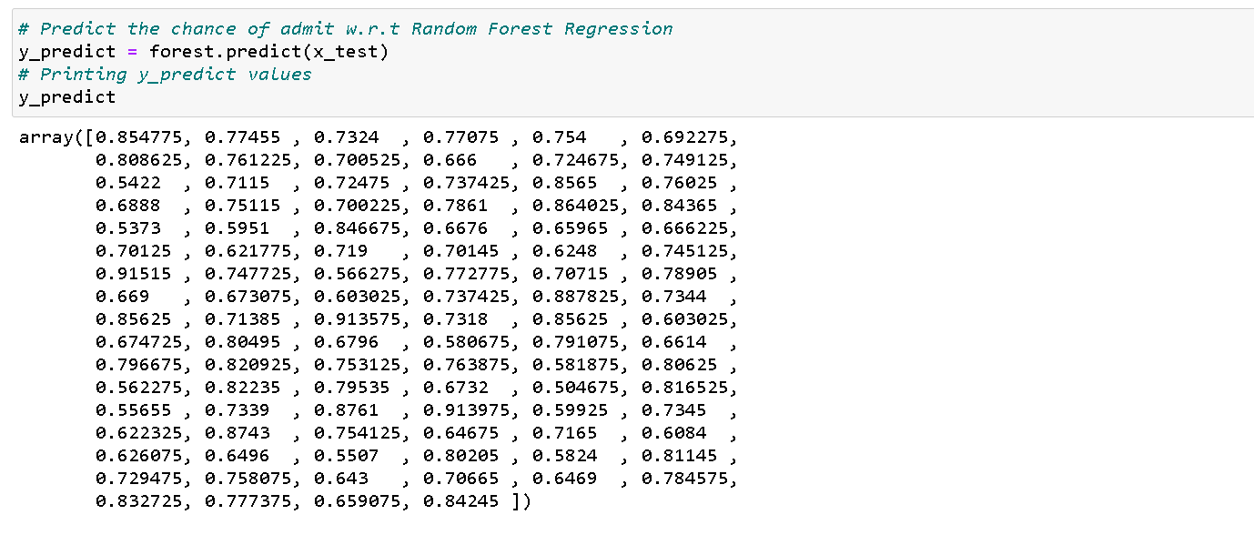
12. Predicting the admit score

Slide 44
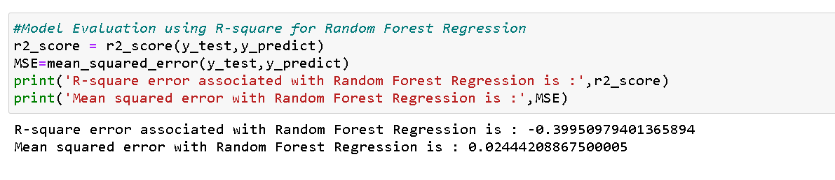
13. Computing the metrics for mean squared error and R-squared to determined the model performance

Slide 45
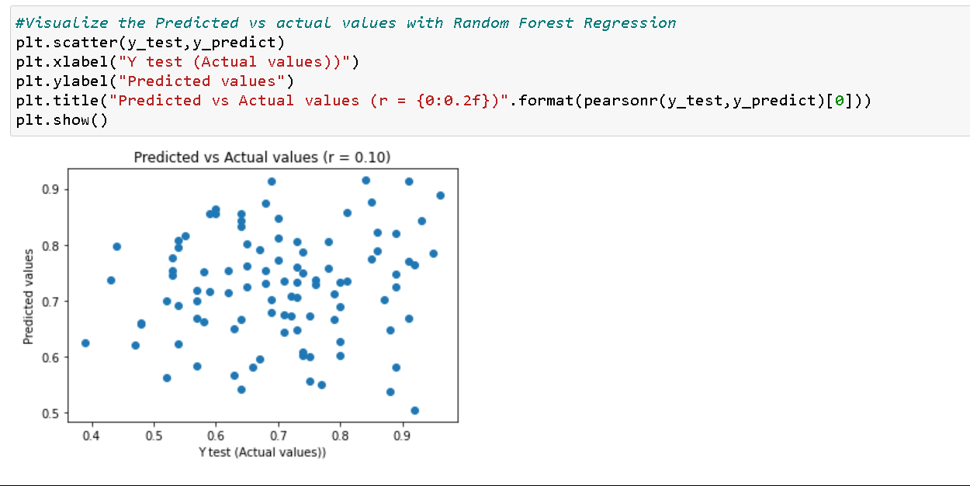
14. Plotting the Predicted vs Actual values using scatterplot w.r.t Random Forest Regressor.

Slide 46
C. MLR with PCA

Slide 47
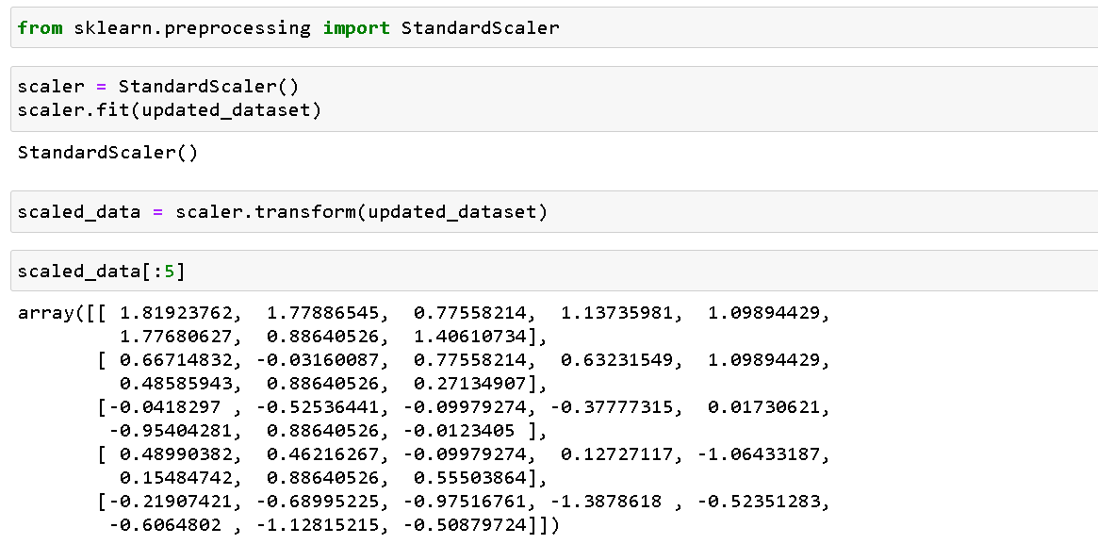
15. Standardizing the data
As we noticed before it is difficult to visualize high dimensional data, we can use PCA to find the first two principal components, and visualize the data in this new , two dimensional space, with a single scatter-plot. Before we do this though, we will need to scale our data so that each feature has a single unit variable.

Slide 48
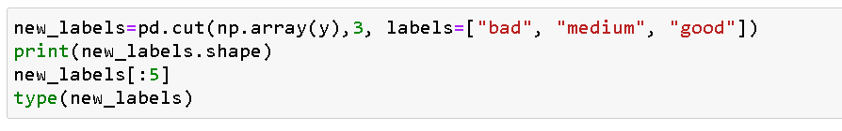
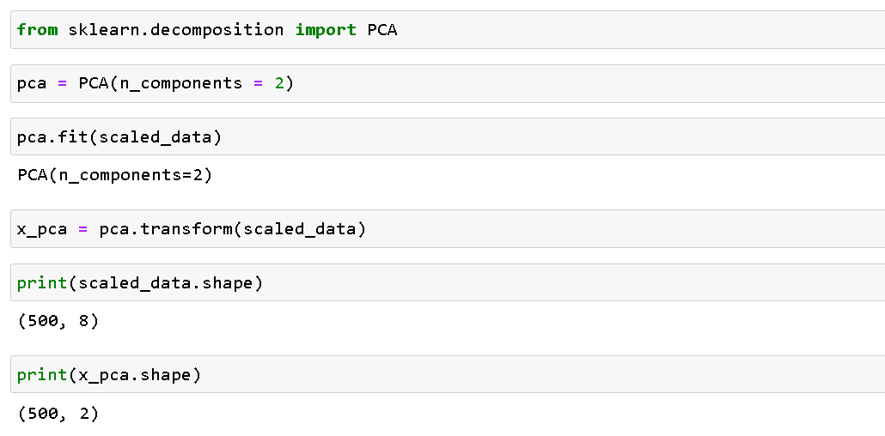
16. Principal Component Analysis (PCA)

Slide 49
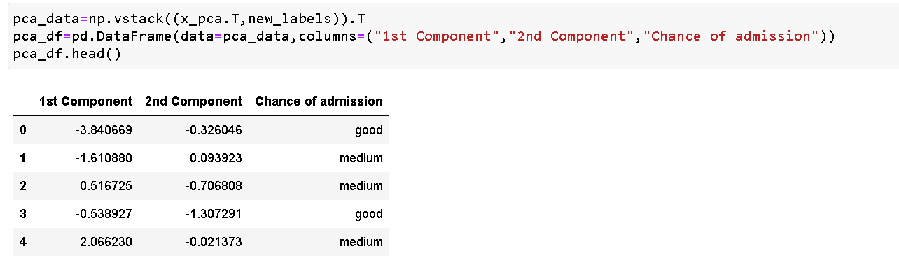
17. After PCA New dataset with 2 features and 1 target variable.

Slide 50
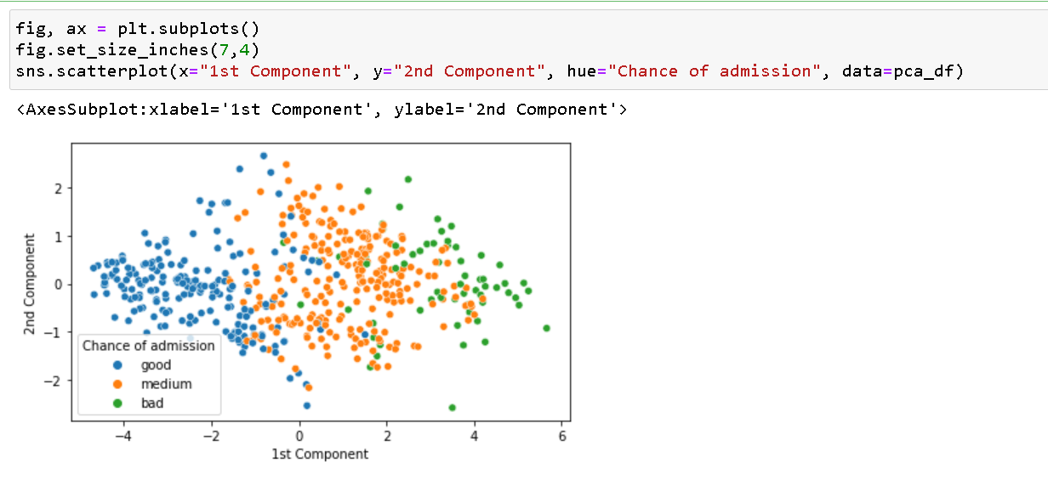
18. Visualizing new dataset

Slide 51
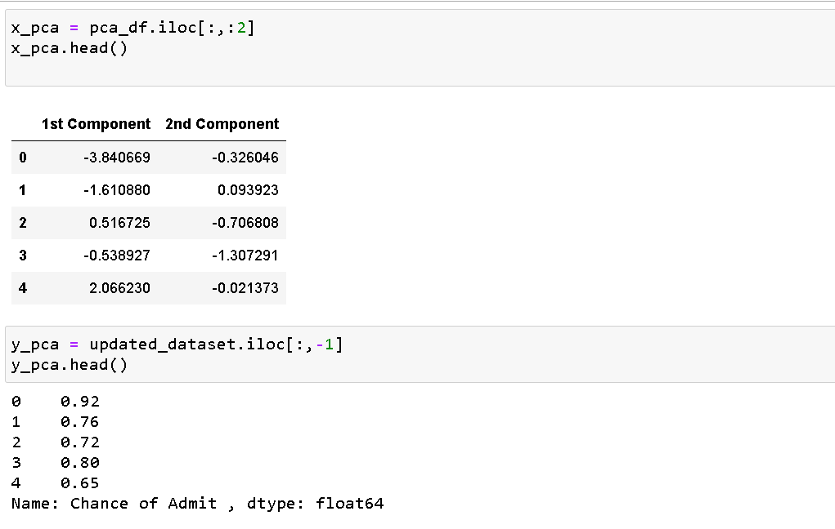
19. Splitting new dataset into independent (x_pca) and dependent (y_pca) variable

Slide 52
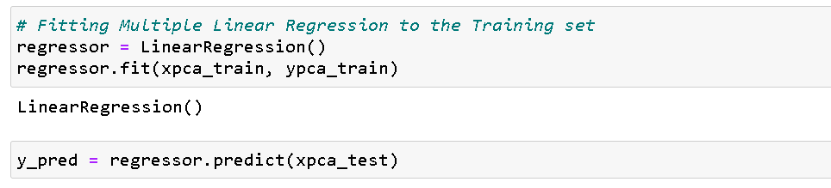
20. Split x_pca and y_pca into training and testing sets
21. Creating Linear Regression object and fitting the model

Slide 53
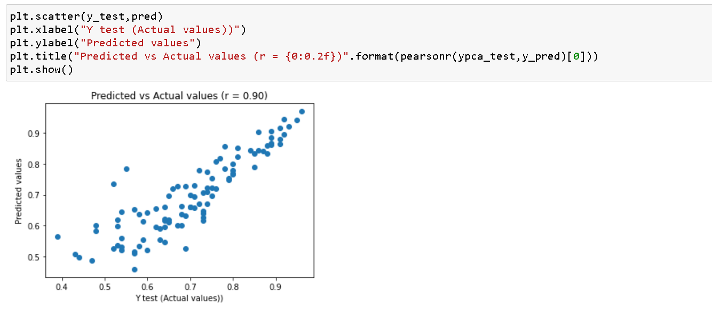
22. Plotting the Predicted vs Actual values using scatterplot w.r.t Muliple Linear Regression

Slide 54
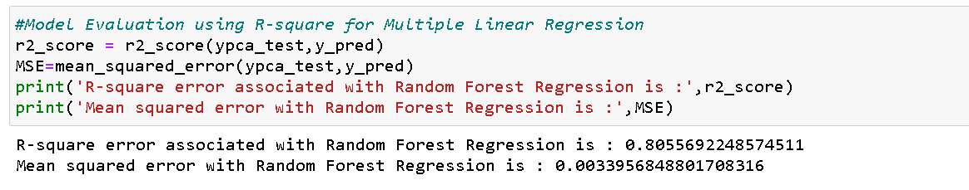
23. Computing the metrics for mean squared error and R-squared to determined the model performance

Slide 55
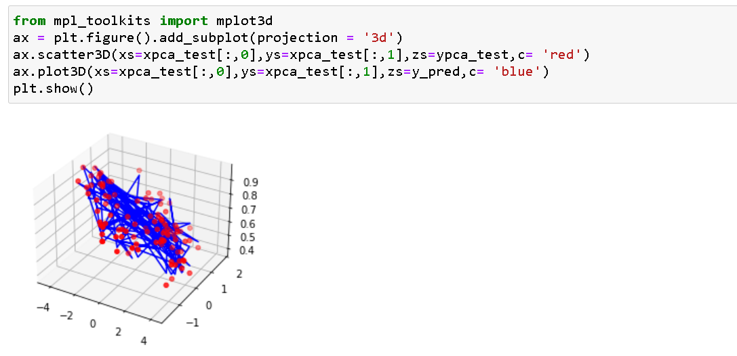
24. Visualizing using 3D graph

Slide 56
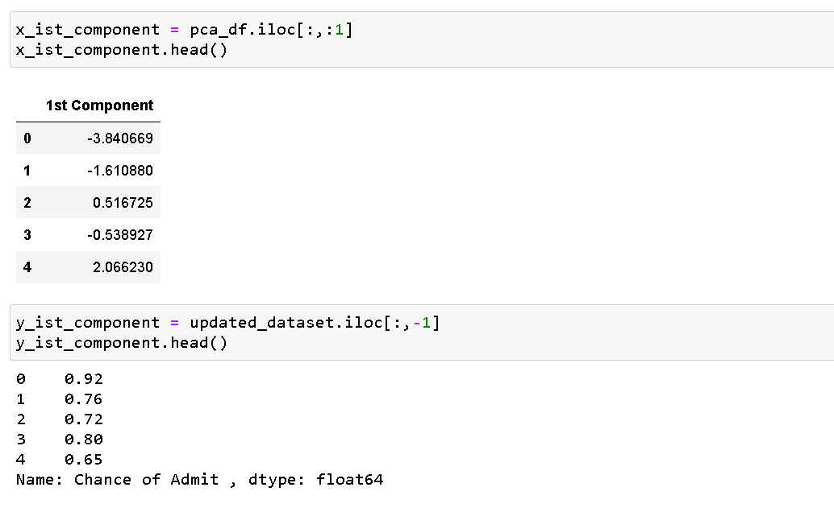
25. Multiple Linear Regression on first component

Slide 57
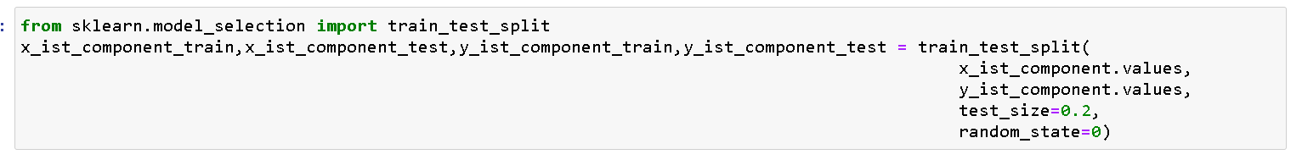
26. Splitting into traning and testing sets

Slide 58
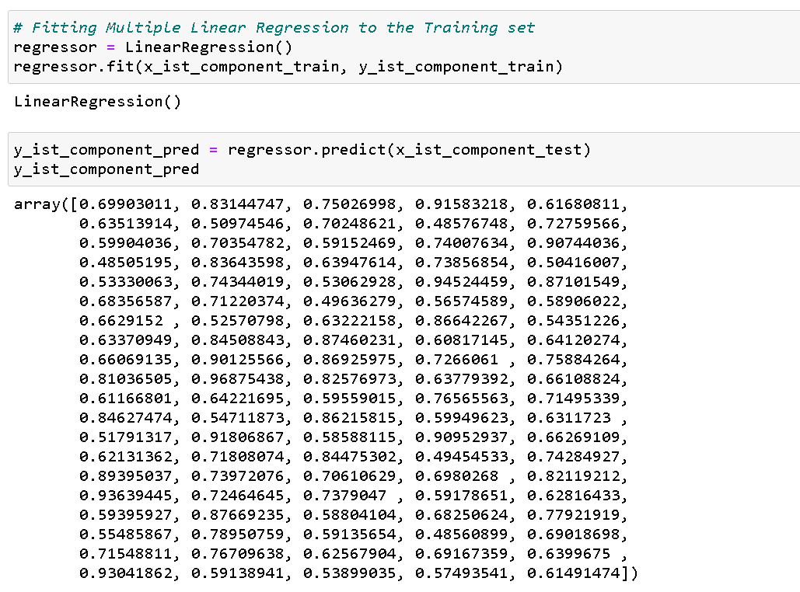
27. Fittting the model and predicting the result.

Slide 59
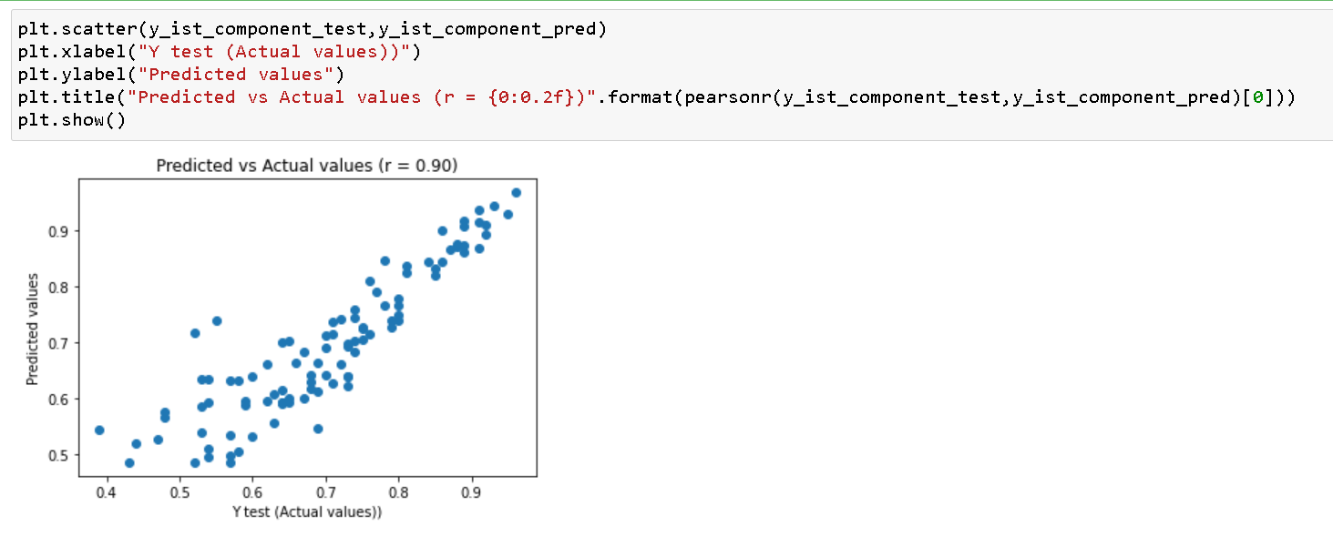
28. Visualizing the Acutal vs Predicted values

Slide 60
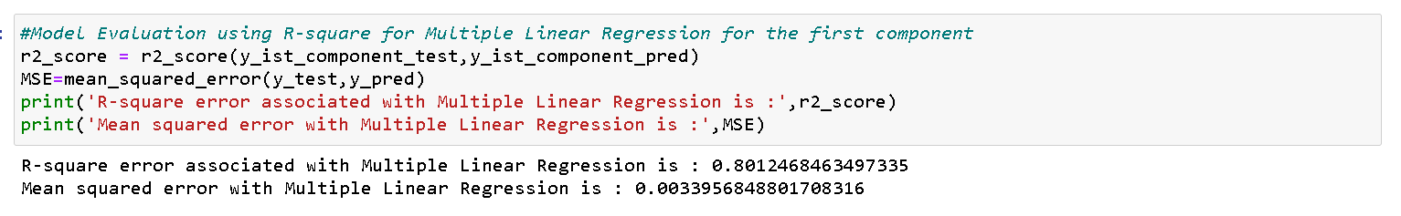
29. Computing the metrics for mean squared error and R-squared to determined the model performance

Slide 61
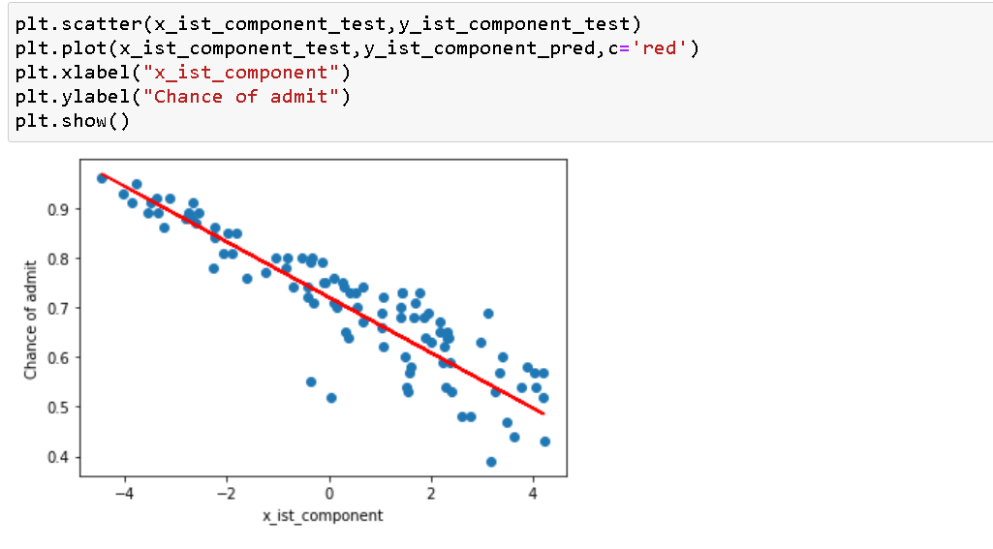
30. Plotting the graph for chance of getting in

Slide 62
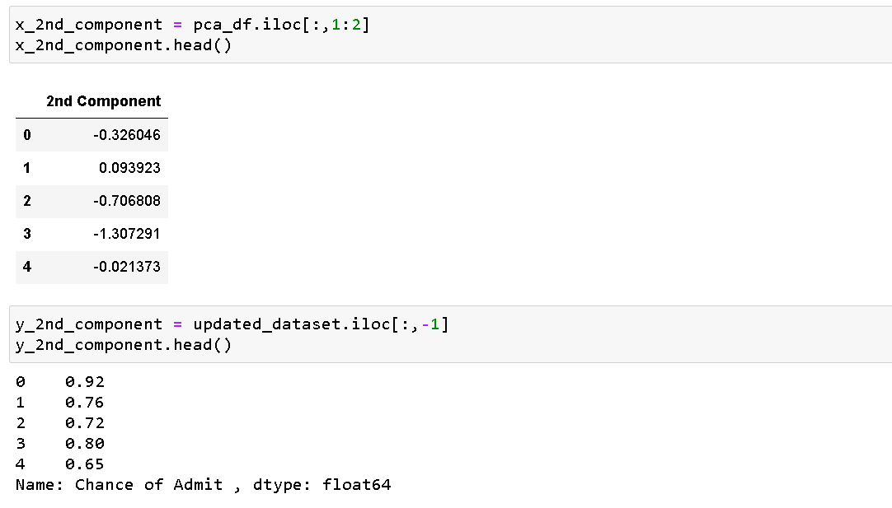
31. Multiple Linear Regression on 2nd component

Slide 63
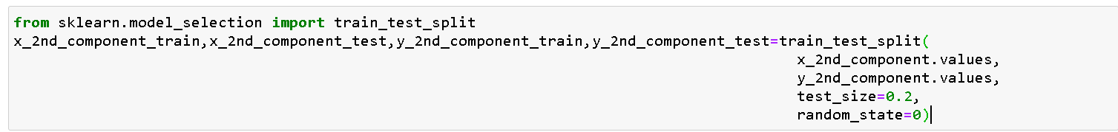
32. Splitting into traning and testing sets

Slide 64
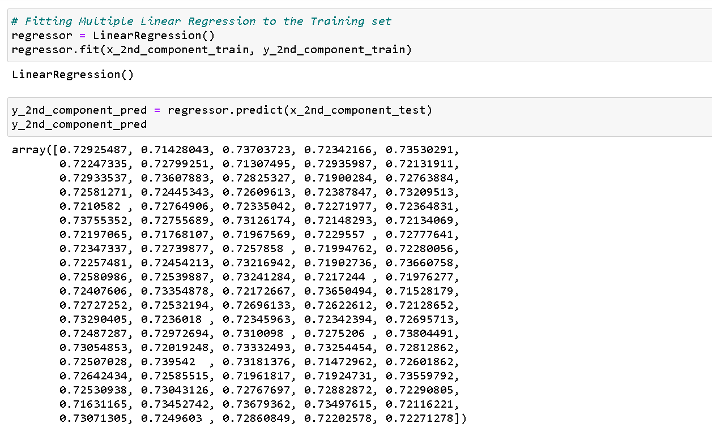
33. Fittting the model and predicting the result.

Slide 65
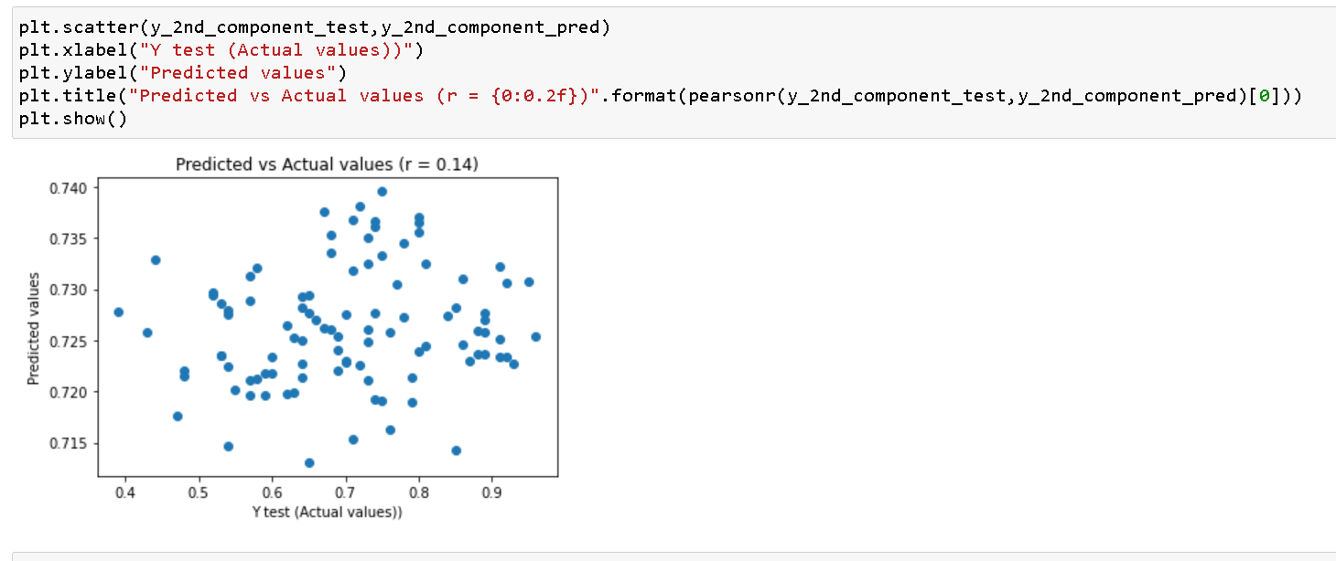
34. Visualizing the Acutal vs Predicted values

Slide 66
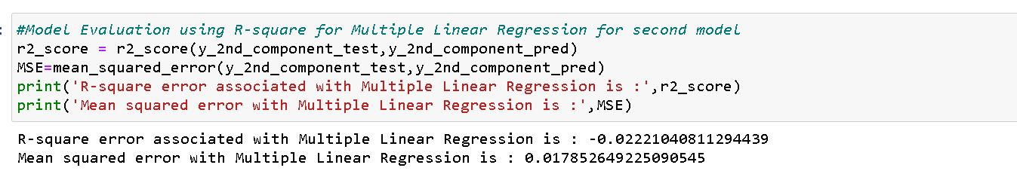
35. Computing the metrics for mean squared error and R-squared to determined the model performance.

Slide 67

36. Plotting the graph for chance of getting in

Slide 68
Clearly Multiple Linear Regression for PCA Ist Component Performs better than second PCA component

Slide 69
D. RFR with PCA

Slide 70

37. Creating Random Forest Regression object and fitting the model

Slide 71

38. Computing the metrics for mean squared error and R-squared to determined the model performance.

Slide 72

39. Random Forest Regression on first PCA component

Slide 73

40. Plotting the graph for chance of getting in

Slide 74

41. Computing the metrics for mean squared error and R-squared to determined the model performance

Slide 75

42. Random Forest Regression on 2nd PCA component

Slide 76

43. Plotting the graph for chance of getting in

Slide 77

44. Computing the metrics for mean squared error and R-squared to determined the model performance

Slide 78
Clearly Random Forest Regression for PCA Ist Component Performs better than second PCA component

Slide 79
Out of Multiple Linear Regression and Random Forest Fegression Mulitple Linear Regression perform better.

